Slide 1

Chap.6 Frequent Itemsets - Market Baskets and the A-Priori Algorithm
Mathis Merle

Slide 2
TABLE OF CONTENTS
REPRESENTATION OF MARKET-BASKET DATA
MONOTONICITY OF ITEMSETS
01
03
USE OF MAIN MEMORY FOR ITEMSET COUNTING
THE A-PRIORI ALGORITHM
02
04
A-PRIORI FOR ALL FREQUENT ITEMSETS
05

Slide 3

01.
REPRESENTATION OF MARKET-BASKET DATA
03

Slide 4
REPRESENTATION OF MARKET-BASKET DATA
$$\underset{\text{basket} \text{with} \text{items} }{\underbrace{\left\{\text{milk}\text{, }\text{apple}\text{, …, }\text{banana}\text{, }\text{carrot} \right\}}}; \left\{\text{coca}\text{,} \text{fish}\text{, …, }\text{cake}\text{, }\text{peer} \right\}; …; \left\{\text{meat}\text{, }\text{apple}\text{, …, }\text{fish}\text{, }\text{egg} \right\}$$
Problem
Solution
Block-by-block processing where only small blocks of data are read into memory at a time. We assume that the frequency will be proportional to the size of the file.
The size of the file of baskets is sufficiently large that it does not fit in main memory.
No overwhelming memory
04

Slide 5


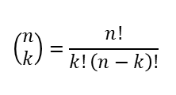


REPRESENTATION OF MARKET-BASKET DATA
$$\underset{\text{basket} \text{with} \text{items} }{\underbrace{\left\{\text{milk}\text{, }\text{apple}\text{, …, }\text{banana}\text{, }\text{carrot} \right\}}}; \left\{\text{coca}\text{,} \text{fish}\text{, …, }\text{cake}\text{, }\text{peer} \right\}; …; \left\{\text{meat}\text{, }\text{apple}\text{, …, }\text{fish}\text{, }\text{egg} \right\}$$
Problem
Solution
Generation of size of the itemsets $k$.
$2≤k≤4$
$If k>4, n↙$
$$t$$
$$\left(\begin{matrix}n \\ k\end{matrix}\right)=\frac{n!}{k!\left(n−k\right)!}$$
Keep the memory and computational time manageable.
$$k$$
05

Slide 6
02.
Use of Main Memory for Itemset Counting
06

Slide 7

USE OF MAIN MEMORY FOR ITEMSET COUNTING
Problem
The challenge is that counting all pairs of items in large datasets can quickly exceed available memory.
Solution
$$\left\{\begin{matrix}\begin{matrix}\text{milk} \\ \text{apple} \\ \text{banana}\end{matrix} & \begin{matrix}1 \\ 2 \\ 3\end{matrix} \\ \begin{matrix}\text{carrot} \\ … \\ \text{egg}\end{matrix} & \begin{matrix}4 \\ … \\ n\end{matrix}\end{matrix}\right\}$$
The Triangular-Matrix Method
The Triples Method
07

Slide 8
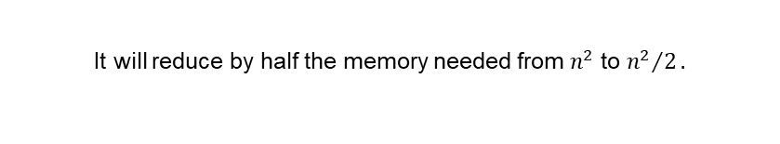
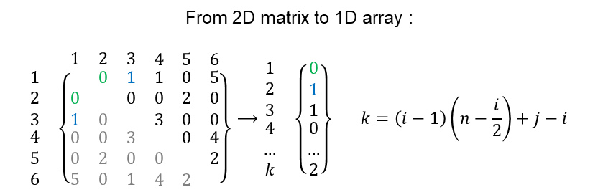
USE OF MAIN MEMORY FOR ITEMSET COUNTING
The Triangular-Matrix Method
Only store the unique pair of items {i,j}, with the rules that $1≤i≤j≤n$.
The goal is to avoid duplicate : count for $\left\{1,2\right\}$ and $\left\{2,1\right\}$.
From 2D matrix to 1D array :
$$\begin{matrix} & \begin{matrix}\begin{matrix}1 & 2 & 3\end{matrix} & \begin{matrix}4 & 5 & 6\end{matrix}\end{matrix} \\ \begin{matrix}\begin{matrix}1 \\ 2 \\ 3\end{matrix} \\ \begin{matrix}4 \\ 5 \\ 6\end{matrix}\end{matrix} & \left\{\begin{matrix}\begin{matrix} & 0 & 1 \\ 0 & & 0 \\ 1 & 0 & \end{matrix} & \begin{matrix}1 & 0 & 5 \\ 0 & 2 & 0 \\ 3 & 0 & 0\end{matrix} \\ \begin{matrix}0 & 0 & 3 \\ 0 & 2 & 0 \\ 5 & 0 & 1\end{matrix} & \begin{matrix} & 0 & 4 \\ 0 & & 2 \\ 4 & 2 & \end{matrix}\end{matrix}\right\}\end{matrix}⟶\begin{matrix}\begin{matrix}\begin{matrix}1 \\ 2 \\ 3\end{matrix} \\ \begin{matrix}4 \\ … \\ k\end{matrix}\end{matrix} & \left\{\begin{matrix}\begin{matrix}0 \\ 1 \\ 1\end{matrix} \\ \begin{matrix}0 \\ … \\ 2\end{matrix}\end{matrix}\right\}\end{matrix} k=\left(i−1\right)\left(n−\frac{i}{2}\right)+j−i$$
It will reduce by half the memory needed from $n^{2}$ to ${n^{2}}/2.$
08

Slide 9

USE OF MAIN MEMORY FOR ITEMSET COUNTING
The Triples Method
The Triples Method is an efficient way to store counts for pairs of items by focusing only on pairs that appear together in the dataset, which is ideal for sparse data.
In cases where 30% or more of pairs have non-zero counts, use the Triples Method.
$$\left\{\begin{matrix}\begin{matrix}1 \\ 1 \\ 1\end{matrix} & \begin{matrix}2 \\ 4 \\ 8\end{matrix} & \begin{matrix}2 \\ 5 \\ 20\end{matrix} \\ \begin{matrix}2 \\ 2 \\ 3\end{matrix} & \begin{matrix}3 \\ 7 \\ 4\end{matrix} & \begin{matrix}15 \\ 6 \\ 9\end{matrix}\end{matrix}\right\}$$
ID of pairs
Count
09

Slide 10
03.
Monotonicity of Itemsets
10

Slide 11

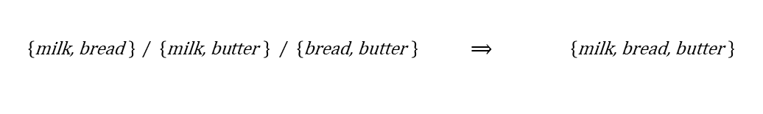
Monotonicity of Itemsets
Concept
If a set of items (an itemset) is frequent, then every subset of that itemset must also at least that frequent.
$$\left\{\text{milk}\text{, }\text{bread}\text{, }\text{butter} \right\}=3 ⟹ \left\{\text{milk}\text{, }\text{bread} \right\}≥3 / \left\{butter\right\}≥3$$
Maximal frequent itemset
$\left\{\text{milk}\text{, }\text{bread} \right\} / \left\{\text{milk}\text{, }\text{butter} \right\}$ $/ \left\{\text{bread}\text{, }\text{butter} \right\} ⟹ \left\{\text{milk}\text{, }\text{bread}\text{, }\text{butter} \right\}$
Reduced Output Size / Avoids redundancy
11

Slide 12
04.
The A-Priori Algorithm
12

Slide 13
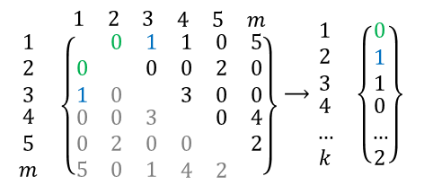
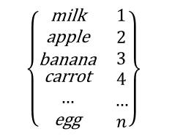
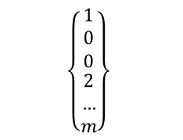

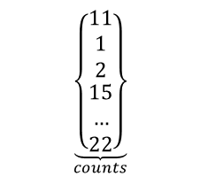

The A-Priori Algorithm
The main problem is the memory a viable, so The A-Priori Algorithm is designed to reduce the number of pairs that must be counted, at the expense of performing two passes over data, rather than one pass.
1st Step
Between Steps
2nd Step
$$\left\{\begin{matrix}\begin{matrix}\text{milk} \\ \text{apple} \\ \text{banana}\end{matrix} & \begin{matrix}1 \\ 2 \\ 3\end{matrix} \\ \begin{matrix}\text{carrot} \\ … \\ \text{egg}\end{matrix} & \begin{matrix}4 \\ … \\ n\end{matrix}\end{matrix}\right\}$$
$$Threshold s⟶select ≅1\%$$
The Triangular-Matrix Method
$$\begin{matrix} & \begin{matrix}\begin{matrix}1 & 2 & 3\end{matrix} & \begin{matrix}4 & 5 & m\end{matrix}\end{matrix} \\ \begin{matrix}\begin{matrix}1 \\ 2 \\ 3\end{matrix} \\ \begin{matrix}4 \\ 5 \\ m\end{matrix}\end{matrix} & \left\{\begin{matrix}\begin{matrix} & 0 & 1 \\ 0 & & 0 \\ 1 & 0 & \end{matrix} & \begin{matrix}1 & 0 & 5 \\ 0 & 2 & 0 \\ 3 & 0 & 0\end{matrix} \\ \begin{matrix}0 & 0 & 3 \\ 0 & 2 & 0 \\ 5 & 0 & 1\end{matrix} & \begin{matrix} & 0 & 4 \\ 0 & & 2 \\ 4 & 2 & \end{matrix}\end{matrix}\right\}\end{matrix}⟶\begin{matrix}\begin{matrix}\begin{matrix}1 \\ 2 \\ 3\end{matrix} \\ \begin{matrix}4 \\ … \\ k\end{matrix}\end{matrix} & \left\{\begin{matrix}\begin{matrix}0 \\ 1 \\ 1\end{matrix} \\ \begin{matrix}0 \\ … \\ 2\end{matrix}\end{matrix}\right\}\end{matrix}$$
$$\left\{\begin{matrix}\begin{matrix}1 \\ 0 \\ 0\end{matrix} \\ \begin{matrix}2 \\ … \\ m\end{matrix}\end{matrix}\right\}$$
$$Size n$$
$$\underset{counts}{\underbrace{\left\{\begin{matrix}\begin{matrix}11 \\ 1 \\ 2\end{matrix} \\ \begin{matrix}15 \\ … \\ 22\end{matrix}\end{matrix}\right\}}}$$
$$Size n$$
$$Size n^{2}⟶\frac{m^{2}}{2}$$
13

Slide 14
05.
A-PRIORI FOR ALL FREQUENT ITEMSETS
14

Slide 15
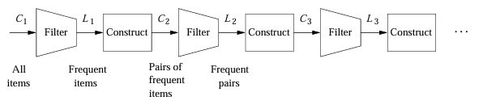



A-priori for all frequent itemsets
The A-Priori algorithm is designed to efficiently find frequent itemsets by systematically narrowing down candidate sets using frequency information from earlier passes, A-Priori limits the number of itemsets that need to be counted, saving on memory and computational resources.
Maximal frequent itemset
$$k=2$$
$$k=3$$
$$k=k+1$$
15

Slide 16
THANKS FOR LISTENING
16

